Slide 1

Automotive Technology: A Systems Approach, 8e
Chapter 43: Automatic Transmission and Transaxle Service
Rob Thompson and Jack Erjavec, Automotive Technology: A Systems Approach, 8th Edition. © 2025 Cengage. All Rights Reserved. May not be scanned, copied or duplicated, or posted to a publicly accessible website, in whole or in part.

Slide 2
Chapter Objectives (1 of 2)
43.01 Identify automatic transmission and transaxle models.
43.02 Replace automatic transmission fluid and filters.
43.03 Perform basic diagnostic procedures on automatic transmissions.
43.04 Describe how to road test the vehicle to diagnose noise and vibration concerns.

Slide 3
Chapter Objectives (2 of 2)
43.05 Perform torque converter tests.
43.06 Diagnose hydraulic control systems.
43.07 Inspect and adjust external linkages.
43.08 Describe the basic steps for overhauling a transmission.

Slide 4
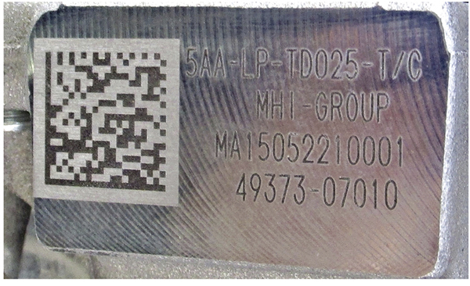
Identification
43.01 Identify automatic transmission and transaxle models.
Pan shape can sometimes be used.
Best method is to used the ID numbers stamped on the case or on a metal tag.
Many use bar codes for quick ID.

Slide 5
Basic Service
Fluid level should be checked regularly.
Follow the manufacturer’s procedure to get an accurate reading.
Many transmissions do not have a dip stick and special fluid checking procedures are required.

Slide 6
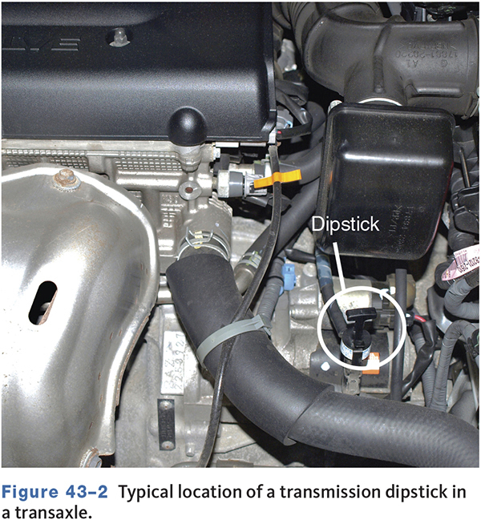
Dipstick

Slide 7
Transmissions Without a Dipstick
Checked similar to a manual transmissions.
Done to prevent overfilling and causing damage.
Some transmissions use a fluid level sensor to alert the driver.

Slide 8
Transmission Fluid
The normal color of ATF is red.
If fluid needs to be added to the transmission, make sure it is the type recommended by the manufacturer.
Check for any TSBs regarding updated fluid specifications.
Synthetic ATF is normally a darker red than petroleum-based fluid.
Smell and appearance are not good indicators of fluid condition.

Slide 9
Checking Transmission Fluid
Wipe the dipstick on absorbent white paper and look at the stain left by the fluid.
    Dark particles are normally band and/or clutch material.
    Silvery metal particles are normally caused by the wearing of the transmission’s metal parts.
If the dipstick cannot be wiped clean, it is probably covered with varnish.
    Varnish will cause the spool valves to stick, causing shifting malfunction.

Slide 10
Knowledge Check (1 of 3)
When should the ATF level be checked on most vehicles?
When the transmission is cool.
When the engine is at operating temperature and the engine is off.
When the transmission is at operating temperature and the engine is on.
It does not matter.

Slide 11
Knowledge Check Answer (1 of 3)
When should the ATF level be checked on most vehicles?
When the transmission is cool.
When the engine is at operating temperature and the engine is off.
When the transmission is at operating temperature and the engine is on.
It does not matter.
Answer: C

Slide 12
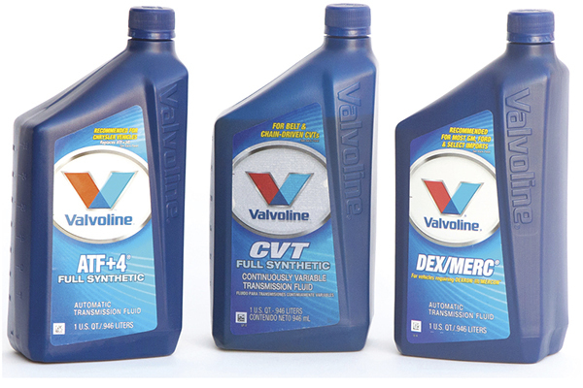
Fluid Changes (1 of 3)
43.02 Replace automatic transmission fluid and filters.
Should be performed if fluid oxidizes or is contaminated.
Often part of the vehicle's maintenance program.

Slide 13
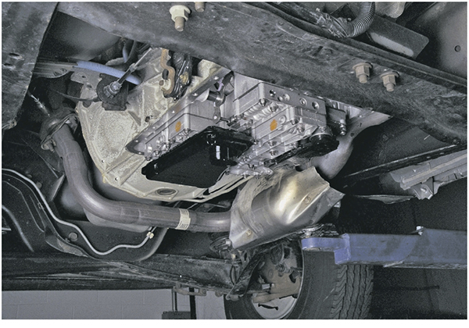
Fluid Changes (2 of 3)
Some transmissions require removing the pan to change the fluid and filter.
Inspect the parking pawl and other components with the pan removed.

Slide 14
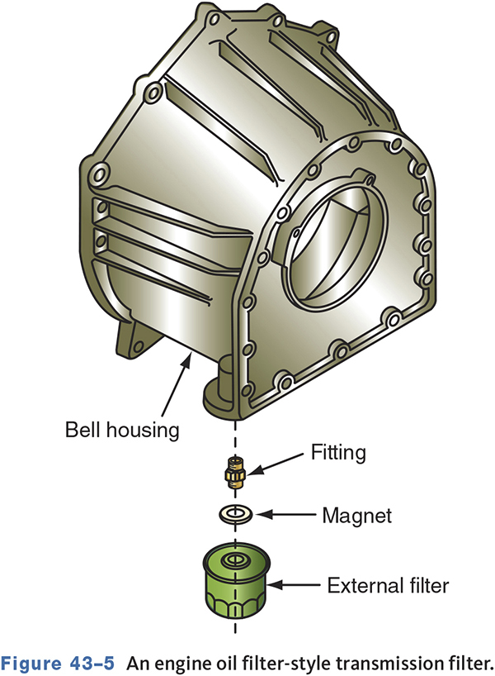
Fluid Changes (3 of 3)
Some transmissions do not have a filter in the pan.
They have a filter similar to an engine oil filter.

Slide 15
Basic Diagnosis (1 of 2)
43.03 Perform basic diagnostic procedures on automatic transmissions.
Commonly caused by poor engine performance.
Hydraulic system problems.
Mechanical malfunctions.
Electronic failures.
Improper adjustments.

Slide 16
Basic Diagnosis (2 of 2)
Begin with fluid check and visual inspection.
A quick way to identify if the engine is causing shifting problems is to connect a vacuum gauge to the engine and take a reading while the engine is running.
Use a scan tool to retrieve DTCs.

Slide 17
Common Sources of Fluid Leaks
Oil pan seal.
Torque converter.
Extension housing seal.
Speedometer drive seal.
Electrical switches.
Case porosity.
Transaxle rear cover and final drive cover.

Slide 18
Fluid Leaks
Pan gaskets are common leak areas.
Remove the inspection cover to inspect the torque converter for leaks.
Check extension housing and axle seals.

Slide 19
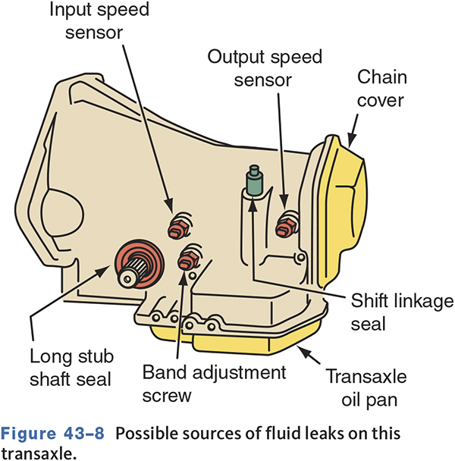
Sources of Transaxle Fluid Leaks

Slide 20
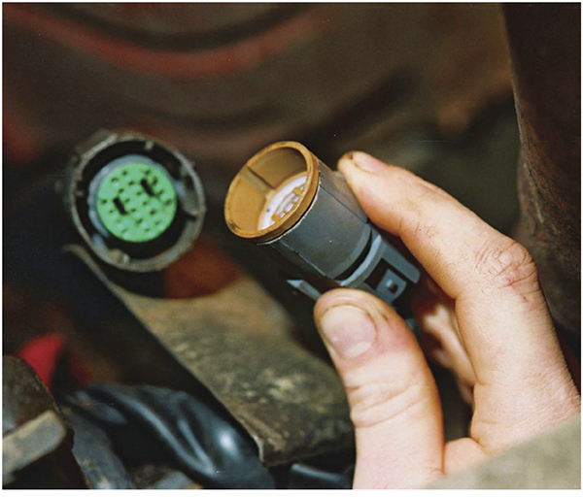
Electrical Connections
Check all electrical connections to the transmission.
Corrosion on transmission range sensor connections can cause erratic shifts.
Verify connections are clean and tight.

Slide 21
Checking Mounts
Engine and transmission mounts are important to transaxle operation.
Inspect mounts for looseness and cracks.
Watch the torque reaction when applying power in forward and reverse.

Slide 22
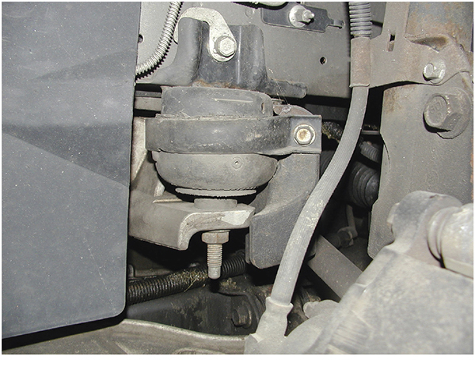
Transaxle Mount Inspection

Slide 23
Knowledge Check (2 of 3)
Technician A says any engine movement can affect the gear engagement. Technician B says delayed shifts can be caused by defective mounts.
Who is correct?

Slide 24
Knowledge Check Answer (2 of 3)
Technician A says any engine movement can affect the gear engagement.
Technician B says delayed shifts can be caused by defective mounts.
Who is correct?
Answer: Both Technician A and B

Slide 25
Transmission Cooler Inspection
Check the engine cooling system.
Inspect the fluid lines between the cooler and transmission.
Inspect the engine coolant for signs of transmission fluid.
Inspect the transmission fluid for signs of engine coolant.

Slide 26
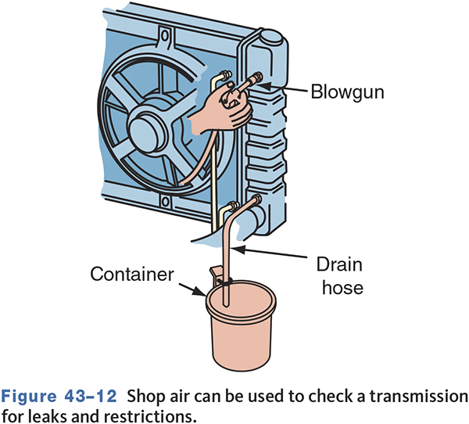
Transmission Cooler

Slide 27
Road Testing the Vehicle
43.04 Describe how to road test the vehicle to diagnose noise and vibration concerns.
Drive the vehicle in a normal manner.
Note pressure and gear changes.
Monitor computer inputs and outputs if available.
Duplicate the customer’s complaint.
Determine if the problem is really being caused by the transmission.

Slide 28
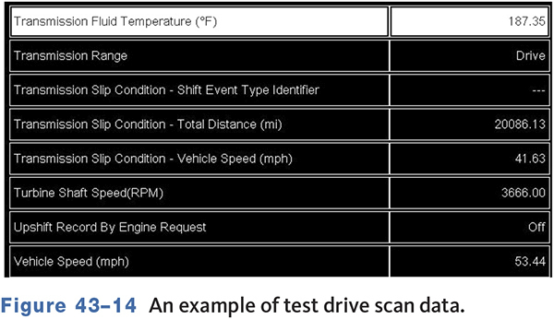
Typical Road Test Data

Slide 29
Diagnosis of Noise and Vibration Problems
Many noise and vibration problems may be caused by things other than the transmission.
  Engine.
  Drive shaft, U-joints, or CV joints.
  Wheel bearings.
  Wheel/tire imbalance.
  Other conditions.

Slide 30
Diagnosis
Most vibration problems are caused by an unbalanced torque converter, a poorly mounted torque converter, or faulty output shaft.
Noise problems are best diagnosed by paying careful attention to the speed and condition at which the noise occurs.

Slide 31
Checking the Torque Converter (1 of 2)
43.05 Perform torque converter tests.
Torque converter problems may include:
Abnormal noises.
  Poor acceleration in all gears.
  Normal acceleration but poor high speed performance.
  Transmission overheating.

Slide 32
Checking the Torque Converter (2 of 2)
An out-of-round converter can cause a complaint of shuddering during TCC engagement or disengagement.
A stall test checks the converter stator clutch’s holding ability as well as the transmission’s clutches and bands.

Slide 33
Converter-Related Cooler Problems
Vehicles with a torque converter clutch may stall when placed into reverse.
  A plugged cooler or cooler lines can prevent pressure from exhausting in the TC.
  This keeps the TCC engaged and causes a stall.

Slide 34
Diagnosing Hydraulic and Vacuum Control Systems
43.06 Diagnose hydraulic control systems.
Check the basics first.
Refer to an oil circuit chart.
Determine what circuits, valves, and apply devices should be operating for each gear.

Slide 35
Pressure Tests
Before conducting a pressure test on an electronic automatic transmission, check and correct all trouble codes retrieved from the system.
Make sure the transmission fluid level and condition are okay.
Connect gauges to test ports and route so that they can be seen on a test drive.

Slide 36
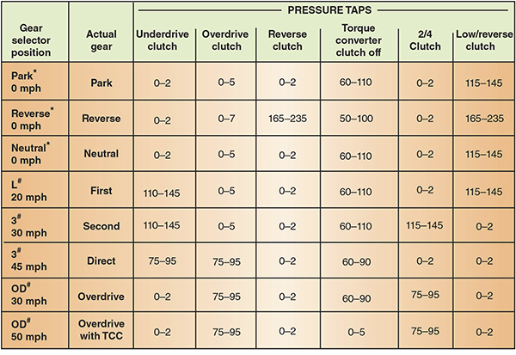
Typical Pressure Test Specifications

Slide 37
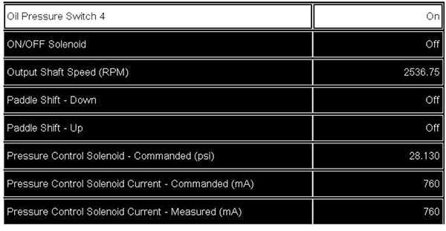
Monitoring Pressure with a Scan Tool

Slide 38
Common Problems
Valve Body
  Thoroughly disassemble, clean, and inspect.
  Freeing and polishing valves may correct the problem.
Servo Assemblies
  Check inner and outer parts of seals.
  Clean, dry, and inspect seals, pistons, springs, and guides.

Slide 39
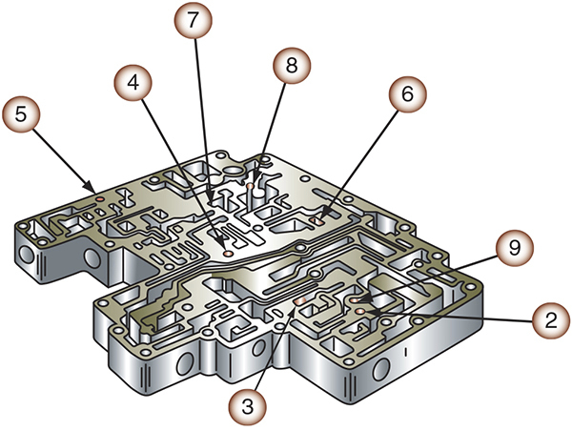
Valve Body Check Balls

Slide 40
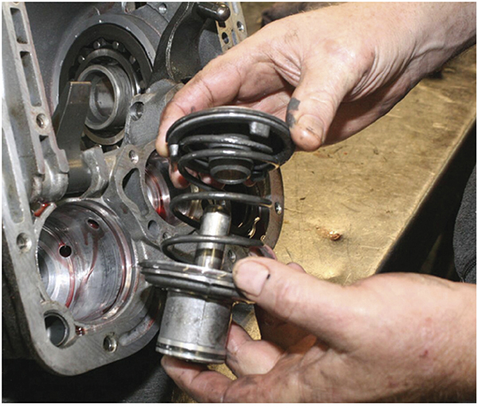
Inspecting the Servo Assembly

Slide 41
Transmission Range Switch (Sensor)
A faulty switch can cause the transmission to not upshift, not stay in gear, delay gear engagement, and allow the engine to start in positions other than park or neutral.
Use a scan tool to monitor the sensor data.
The TR sensor won’t work properly if the gear shift linkage is out of adjustment.

Slide 42
Linkages (1 of 2)
43.07 Inspect and adjust external linkages.
Many problems can be associated with incorrect linkage adjustments.
Gear selector linkage
    The manual shift valve must fully engage the selected gear.
    Poor gear engagement, slipping, and excessive wear can result from misadjustment.

Slide 43
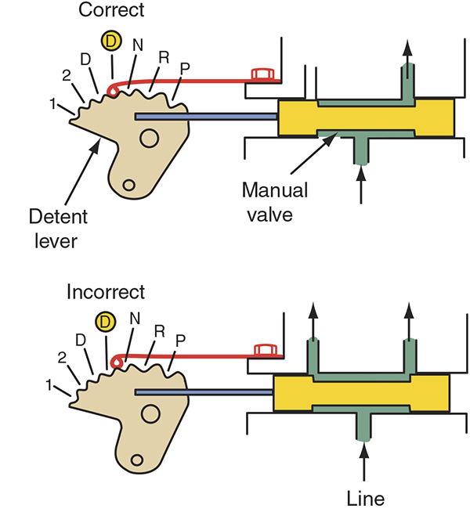
Linkages (2 of 2)

Slide 44
Knowledge Check (3 of 3)
Which of the following can affect transmission operation?
    A. Incorrect engine operation.
    B. Improper linkage adjustment.
    C. Low fluid level.
    D. All of the above.

Slide 45
Knowledge Check Answer (3 of 3)
Which of the following can affect transmission operation?
    A. Incorrect engine operation.
    B. Improper linkage adjustment.
    C. Low fluid level.
    D. All of the above.
    Answer: D. All of the above

Slide 46
Transmission Overhaul (1 of 6)
43.08 Describe the basic steps for overhauling a transmission.
Before removing the transmission:
    Inspect the torque converter bolts.
    Index the flexplate to the converter.
    Remove the battery ground cable.
    Disconnect linkages, cooler lines, and wiring.
    Remove the dipstick tube.

Slide 47
Transmission Overhaul (2 of 6)
Inspect the flexplate for cracks or damage.
Inspect the TC drive lugs, check for ballooning, check balance weights, pilot and drive hub.
Check flexplate and converter drive hub for runout.
Check the end play of the input shaft.

Slide 48
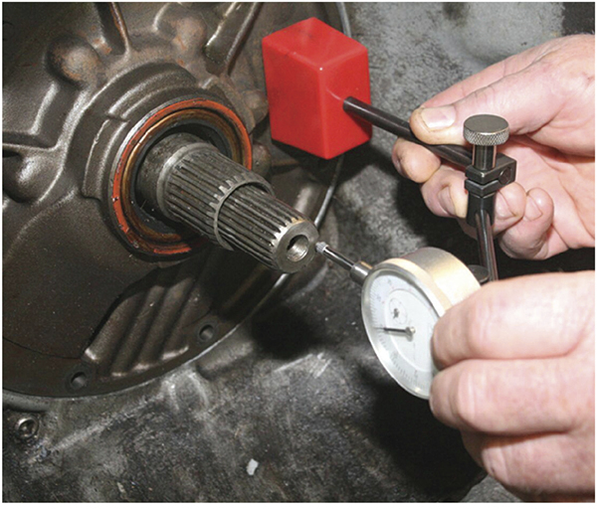
Transmission Overhaul (3 of 6)

Slide 49
Transmission Overhaul (4 of 6)
Replace the converter if there is any doubt of its condition.
Inspect drive chains for stretch and side play.
Check all pumps, valve bodies, and cases for warpage.
Keep parts absolutely clean.
Use correct size thrust washers.
Soak friction plates in clean ATF before installing.

Slide 50
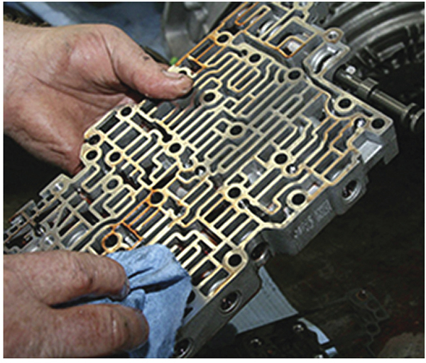
Transmission Overhaul (5 of 6)

Slide 51
Transmission Overhaul (6 of 6)
Always use new gaskets and seals.
Ensure all wiring is connected.
Flush the transmission cooling system.
Use only lint-free cloths.

Slide 52
Installation
Check alignment dowels and holes.
Make sure pilot hole in crank is smooth.
Make sure pilot hub is smooth and lubricated.
Flush the converter.
Check converter endplay and height.
Pour one quart of ATF into the TC before mounting to the transmission.

Slide 53
Chapter Reflection
Describe the concept from this chapter that challenged you the most.
Describe what made the concept difficult for you and the steps you took to improve your understanding.
How could you help another learner who was struggling with the same concept.
Use 100–150 words in your answer.

